Slide 1
Introduction
Way of working, Git, Maven, Java
{Dev}School Java Edition
02.05.2023

Slide 2
How to contact us?
Whatsapp group
Email: devschool.tech@gmail.com

Slide 3
Git
Git is an Open Source Distributed Version Control System.
Control System: it can be used to store content
Version Control System: Many developers can add code in parallel. Git in handling this by maintaining a history of what changes have happened
Distributed Version Control System: Git has a remote repository which is stored in a server and a local repository which is stored in the computer of each developer. Git is a Distributed Version Control System since the code is present in every developer’s computer

Slide 4
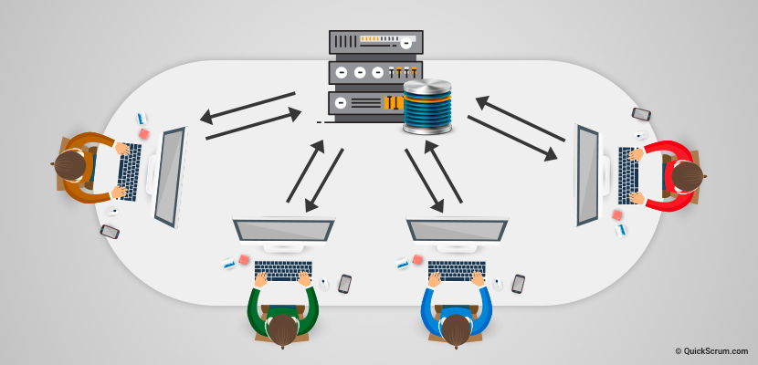
Why do we need Git?
working in parallel
no code conflicts
revert changes

Slide 5
What is a branch?
Git branches are effectively a pointer to a snapshot of your changes
When you want to add a new feature or fix a bug you spawn a new branch to encapsulate your changes
This makes it harder for unstable code to get merged into the main code base, and it gives you the chance to clean up your future's history before merging it into the main branch.

Slide 6
Working with Git

Slide 7
Let’s start using Git
init
add
branch
checkout
clone
status
commit
pull
log
rebase
push

Slide 8
Maven

Slide 9
Maven
Build automation tool
Mainly used for Java projects
Stores libraries and plugins in a central repository (https://search.maven.org/)
Uses conventions for build structure

Slide 10
Maven – How does it work?
Build controller via pom.xml (Project Object Model)
Uses a standard build order, directories, plugins
Dependency management
Identifies dependencies in the pom.xml
One POM can call child POM’s

Slide 11
Let’s jump into Java

Slide 12
public static void main (String[] args){}
Is the most important Java method.
The Java main method is the entry point of any java program.
Java main method accepts a single argument of type String array. This is also called as java command line arguments.

Slide 13

Let’s talk about memory
Objects are created in an area of memory called heap
References(addresses) to objects are kept on stack
Stack memory contains primitives and references

Slide 14
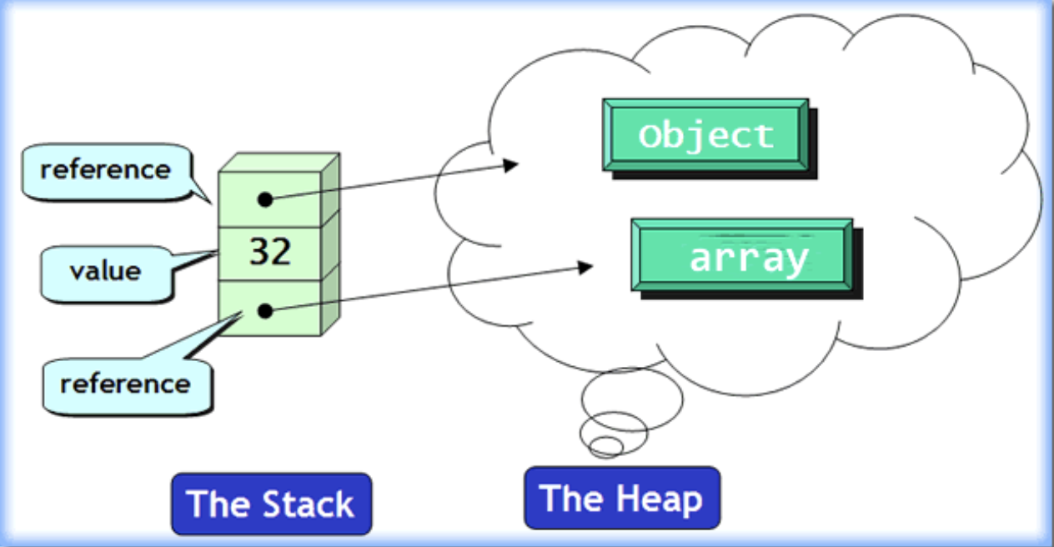

Slide 15
Java 17 features
Text Blocks
Switch expressions
Records
Sealed classes

Slide 16
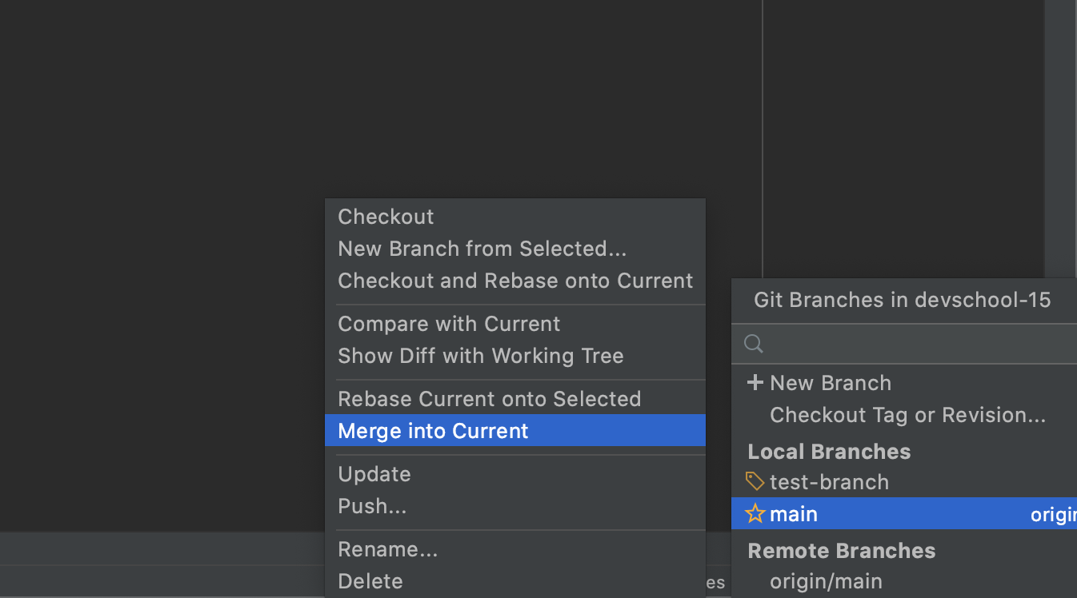
At the end of each session
Take latest changes from main
Push the local changes from your branch
git add …
git commit –m “Enter_commit_message”
git push
Check if the changes were pushed by looking in the github portal

